Slide 1
CER3C3 Data Structures
Lecture 6

Slide 2
Queue Implementation
CREATEQ(Q) :: = declare Q(1:n); front ← rear ← 0
ISEMTQ(Q) :: = if front = rear then true else false
FRONT(Q) :: = if ISEMTQ(Q) then error else Q(front + 1)
procedure ADDQ(item, Q, n, rear) //insert item into the queue represented in Q(l:n)//
if rear = n then call QUEUE_FULL
rear ← rear + 1
Q(rear) ← item
end ADDQ
procedure DELETEQ(item, Q, front, rear) //delete an element from a queue//
if front = rear then call QUEUE_EMPTY
front ← front + 1
item ← Q(front)
end DELETEQ

Slide 3
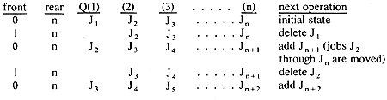
Queue Example

Slide 4
Have you observed any limitation??

Slide 5
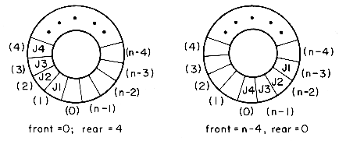
Circular Queue

Slide 6
Circular Queue Implementation
procedure ADDQ(item, Q, n, front, rear)
//insert item in the circular queue stored in Q(0: n-1); rear points to the last item and front is one position
counterclockwise from the first item in Q//
rear ← (rear + 1) mod n //advance rear clockwise//
if front = rear then call QUEUE-FULL
Q(rear) ← item //insert new item//
end ADDQ
procedure DELETEQ(item, Q, n, front, rear)
//removes the front element of the queue Q(0:n - 1)//
if front = rear then call QUEUE-EMPTY
front ← (front + 1) mod n //advance front clockwise//
item ← Q(front) //set item to front of queue//
end DELETEQ

Slide 7
Points to Note : Circular Queue
One surprising point in the two algorithms is that the test for queue full in ADDQ and the test for queue empty in DELETEQ are the same.
In the case of ADDQ, however, when front = rear there is actually one space free, i.e. Q(rear), since the first element in the queue is not at Q(front) but is one position clockwise from this point.
However, if we insert an item here, then we will not be able to distinguish between the cases full and empty, since this insertion would leave front = rear.
To avoid this, we signal queue-full thus permitting a maximum, of n - 1 rather than n elements to be in the queue at any time. One way to use all n positions would be to use another variable, tag, to distinguish between the two situations, i.e. tag = 0 if and only if the queue is empty.

Slide 8
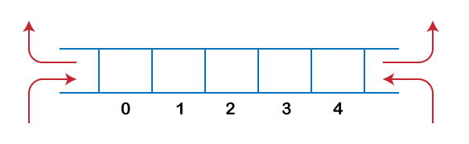
Double Ended Queue
A double ended queue (deque) is a linear list in which additions and deletions may be made at either end. Obtain a data representation mapping a deque into a one dimensional array.
It can be used as a Stack
Two Types : Input Restricted; Output Restricted

Slide 9
Operations on Dequeue
Insert from Front
Insert from Rear
Delete from Front
Delete from Rear

Slide 10
How would you implement Two Stack/Queue??
Let us consider an array V(1:m).
We can use V(1) for the bottom most element in stack 1 and V(m) for the corresponding element in stack 2.
Stack 1 can grow towards V(m) and stack 2 towards V(1). It is therefore possible to utilize efficiently all the available space.
Can we do the same when more than 2 stacks are to be represented? The answer is no, because a one dimensional array has only two fixed points V(1) and V(m) and each stack requires a fixed point for its bottommost element.

Slide 11
More than Two Stacks??
When more than two stacks, say n, are to be represented sequentially, we can initially divide out the available memory V(1:m) into n segments and allocate one of these segments to each of the n stacks.
This initial division of V(1:m) into segments may be done in proportion to expected sizes of the various stacks if the sizes are known. In the absence of such information, V(1:m) may be divided into equal segments.
For each stack i, we shall use B(i) to represent a position one less than the position in V for the bottommost element of that stack. T(i), 1 ≤ i ≤ n will point to the topmost element of stack i. We shall use the boundary condition B(i) = T(i) iff the i'th stack is empty. If we grow the i'th stack in lower memory indexes than the i + 1'st, then with roughly equal initial segments we have
B (i) = T (i) = ⌊m/n⌋ (i - 1), 1 ≤ i ≤ n
as the initial values of B(i) and T(i), Stack i, 1 ≤ i ≤ n can grow from B(i) + 1 up to B(i + 1) before it catches up with the i + 1'st stack.

Slide 12
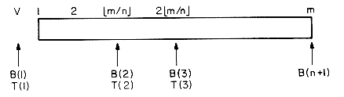
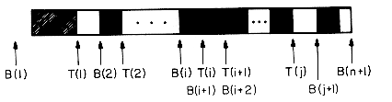
Multiple Stack Configuration

Slide 13
ADD and DELETE operations
procedure ADD(i,X)
//add element X to the i'th stack, 1 ≤ i ≤ n//
if T(i) = B(i + 1) then call STACK-FULL (i)
T(i) ← T(i) + 1
V(T(i)) ← X //add X to the i'th stack//
end ADD
procedure DELETE(i,X)
//delete topmost element of stack i//
if T(i) = B(i) then call STACK-EMPTY(i)
X ← V(T(i))
T(i) ← T(i) - 1
end DELETE

